Slide 1
February 2, 2020
Today begins
the First 50-Year Cycle Dedicated
to the Preservation and Advancement
of Mexican American Culture
Ceremonia will be led by Ramon D. Vasquez, Coahuilteca Nation, American Indians in Texas at Spanish Colonial Missions

Slide 2
Armando Rendón
is the author of Chicano Manifesto, published in 1971; a writer of novels for young adults, and founder and editor of Somos en escrito Magazine.

Slide 3
CULTURE
Define our culture. Be able to tell the world what makes us Mexican Americans. Assert a specific identity we can embrace and put forward for our children and to the rest of U.S. society.

Slide 4
OUR OWN VOICE
Forge a common voice, that is, an understanding of our history, our culture, and our contributions to the U.S. that we can share among ourselves and with society in general.

Slide 5
ALLIANCES WITH
U.S. INDIGENOUS PEOPLES
Build strong, working, and respectful alliances with other indigenous peoples in the U.S. Study Treaty of Guadalupe Hidalgo as living international document and implications for Mexican Americans

Slide 6
ALLIANCES WITH INDIGENOUS PEOPLES IN THE AMERICAS
Share our common values with indigenous peoples throughout the Americas to form cross-national alliances. Form working relationships to find common cultural and philosophical ties.

Slide 7
LITERATURE AND THE ARTS
Encourage the growth of our writers and artists in recovering ancient artistic traditions and creating new, powerful styles of art, music and song to lead and accompany us into the next half century.

Slide 8
EDUCATION
Create a method of teaching which imparts not only knowledge but wisdom to our children, an education rooted in ancient philosophies while mindful of the principles of learning in todays’ world.

Slide 9
Dr. Maria Zentella
is a Social and Cultural Anthropologist dedicated as an Independent Scholar to the study and research of the expressive culture and history of Mexican American and Latino Communities.

Slide 10
MEXICAN AMERICAN HISTORICAL AND CULTURAL IDENTITY
Narrative by Dr. C. Maria Zentella, Social and Cultural Anthropologist and
Independent Scholar dedicated to cultural research and education with Ethnodramas.
Music by Binisa Zentella, Folklorist and Musician. Both are founding members of
Los Inocentes Cultural Research and Cultural Performing Project

Slide 11
THE TREATY OF
GUADALUPE HIDALGO
SIGNED ON FEBRUARY 2ND OF 1848 SIGNALED THE BIRTH OF MEXICANOS
AS MEXICAN AMERICANS IN OUR ANCESTRAL LANDS

Slide 12
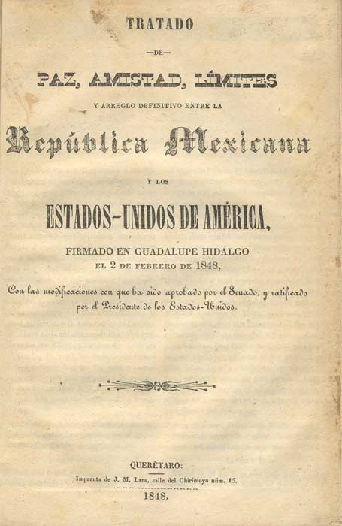

Slide 13
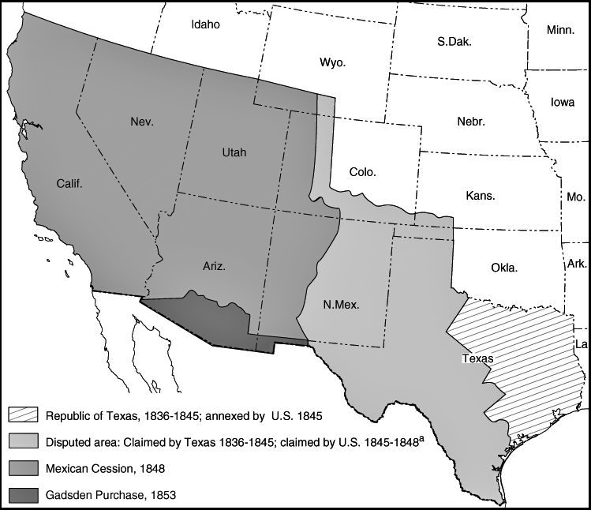

Slide 14
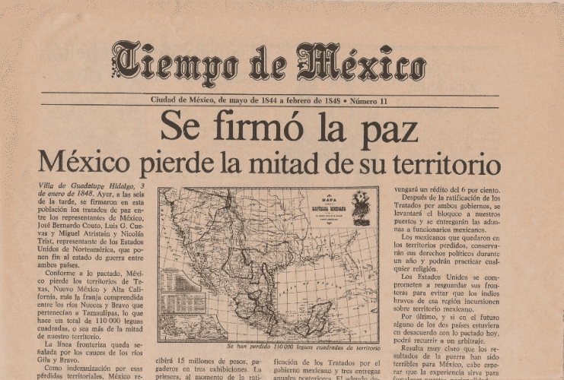

Slide 15
MEXICAN AMERICAN CULTURAL IDENTITY
HISTORICALLY EVOLVED INSTILLED BY HUMAN
PRACTICES OF COMMUNITY SOLIDARITY,
RESPECT AND JUSTICE
THROUGH PEACEFUL MEANS
FOR THE DIGNITY OF LIFE
IN ALL ITS MANIFESTATIONS

Slide 16
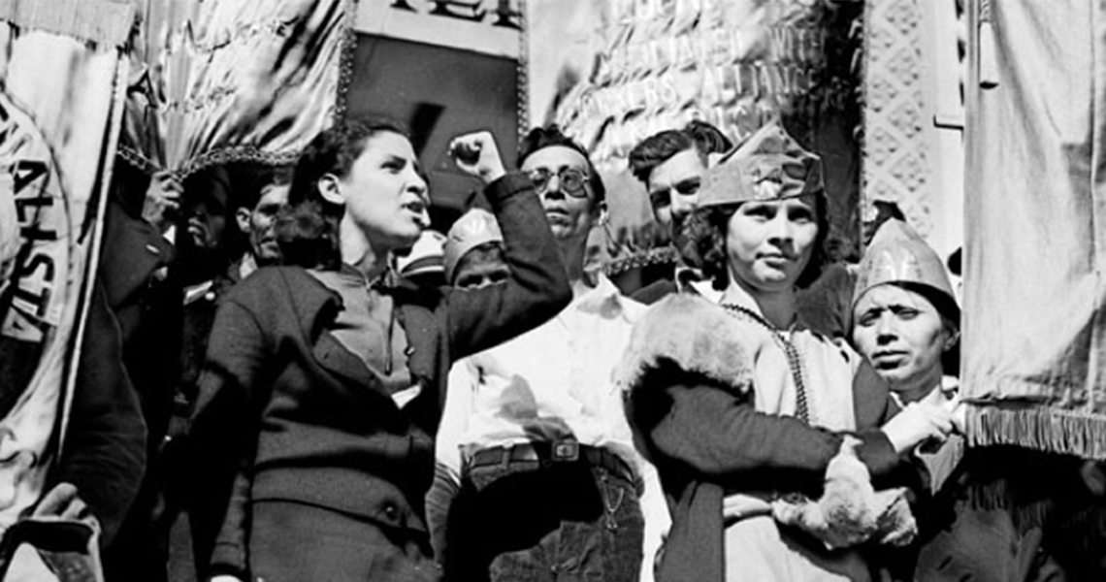

Slide 17
MEXICAN AMERICAN CULTURAL IDENTITY IS EXPRESSED IN ARTISTIC AND CREATIVE PRACTICES EVOLVED IN SPANISH, SPANGLISH, ENGLISH AND INDIGENOUS LANGUAGES, REPRESENTED IN ALL ARTISTIC FORMS

Slide 18
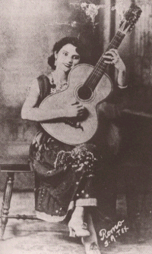

Slide 19
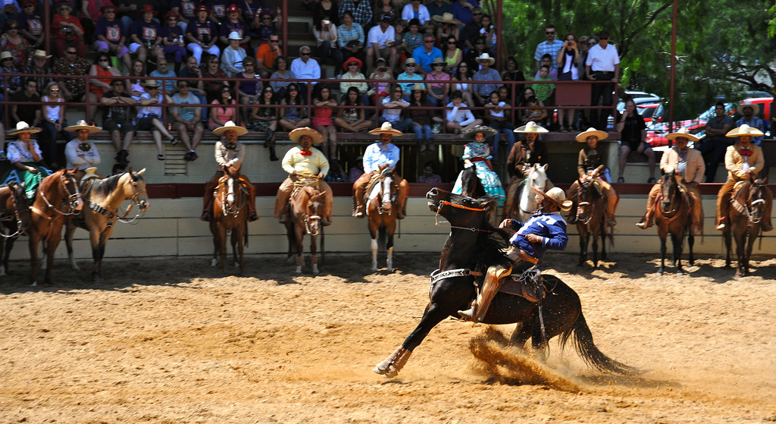

Slide 20
THE SOCIAL, ECONOMIC AND POLITICAL
IDEALS OF JUSTICE, EQUALITY AND
EDUCATION WERE FORGED IN THE
CHICANO CIVIL RIGHTS MOVEMENT
OF THE 1960S AND 1970S

Slide 21
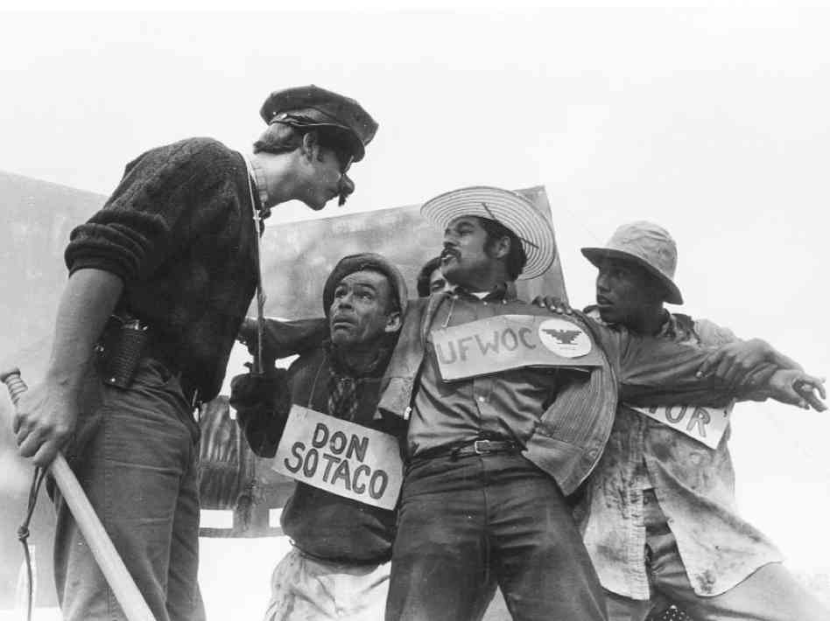

Slide 22
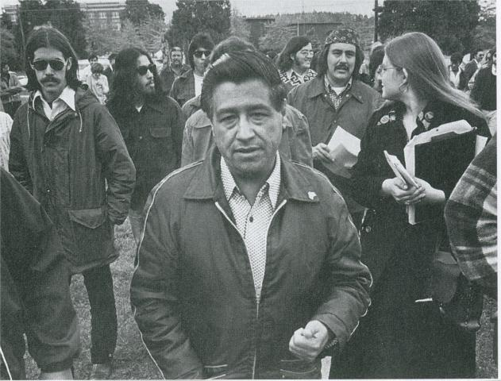
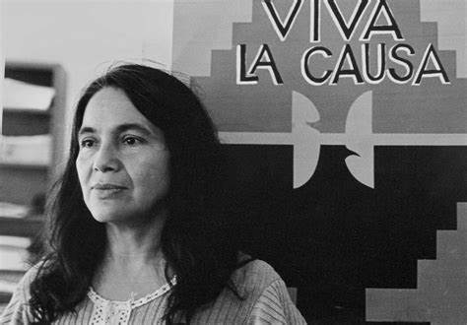

Slide 23
MEXICAN AMERICAN HISTORICAL AND
CULTURAL COLLECTIVE MEMORY
FORGED DURING ALMOST TWO CENTURIES
HAS TO BE TRANSMITTED, TAUGHT AND
REAPPROPRIATED BY ALL
MEXICAN AMERICAN GENERATIONS TO
OWN THEIR PAST AND OWN THEIR FUTURE.

Slide 24
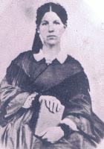
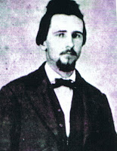
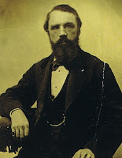

Slide 25
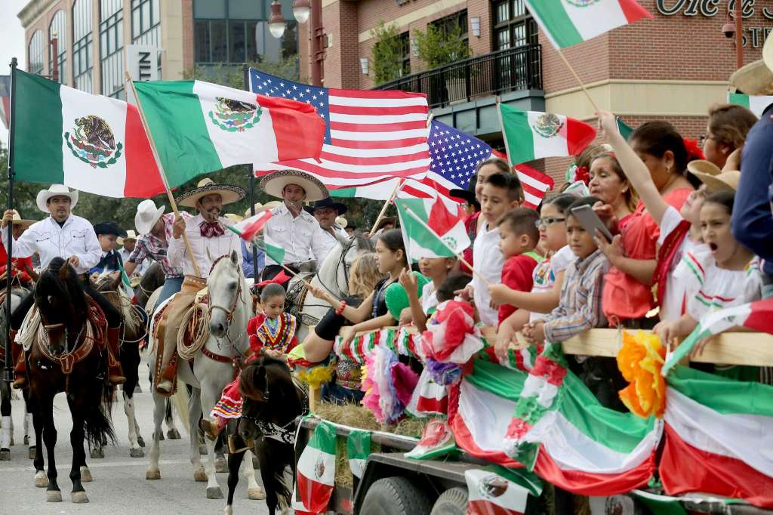

Slide 26
Dr. Ernesto Mireles
professor of Chicano Studies and Organizing at Prescott College, Prescott, Arizona.

Slide 27
TEZCATLIPOCA
Indigenous Xicano Organizing a proposed Blueprint for the next 50 years

Slide 28

Quetzalcoatl –
Beautiful Knowledge
Centralized policy or mission.
Build a network of organizers who understand the implications of nation building.
Leadership through cultural political education.
Low Intensity Organizing

Slide 29
Basic structure/How it works
Huitzilopochtli
- Action
Divide country into regions.
  Survey of hot spots around the country. Where are Xicana/os moving socially, politically and culturally?
Develop one contact per region
  Reach out to specific organizers with materials, i.e. The Blueprint, Think Tank and national organizing plan.
Direct training through a four day seminar.
Education/organizing committees in respective communities that feed information into the think tank.

Slide 30
The question is not can we build this network,
but what are we going to do with it once it’s built.
XIPE TOTEC
- Transformation

Slide 31
Jacqueline
born and raised in San Antonio, is an MSW candidate at the University of Texas at San Antonio.
Binisa
is a folklorist, musician and a founding member of Los Inocentes Cultural Research and Cultural Performance Project.

Slide 32
Contact links:
Email address: 2020MeXicano2070@gmail.com
Facebook page: MeXicanos2070
Website: MeXicanos2070.weebly.com
Twitter handle: @XicanX2070

Slide 33
De Colores
First stanza
De colores, de colores se visten los campos en la Primavera,
De colores, de colores son los pajarillos que vienen de afuera
De colores, de colores es el Arco Iris que vemos lucir
Y por eso los grandes amores, de muchos colores me gustan a mi
Y por eso los grandes amores, de muchos colores me gustan a mi

Slide 34
Second stanza
Canta el gallo, canta el gallo con el quiri quiri quiri quiri quiri
La gallina, la gallina con el cara cara cara cara cara
Los polluelos, los polluelos con el pio pio pio pio pi
Y por eso los grandes amores, de muchos colores me gustan a mi
Y por eso los grandes amores, de muchos colores me gustan a mi

Slide 35
Contact links:
Email address: 2020MeXicano2070@gmail.com
Facebook page:
MeXicanos2070
Website: MeXicanos2070.weebly.com
Twitter handle: @XicanX2070

